Slide 1
Excel Functions

Slide 2
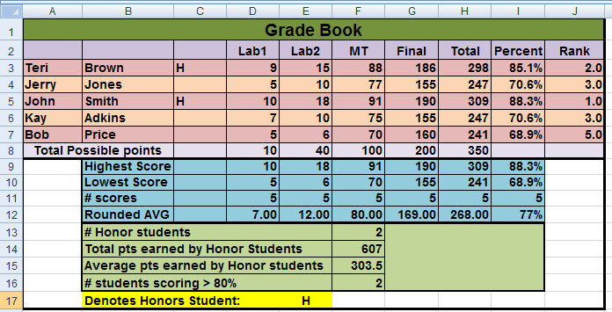
Grade Book worksheet
File 1-Excel Training Part 1

Slide 3
Common Basic Functions
= SUM(number1, number2, …) | Calculates the sum of a list of values
=AVERAGE(number1, number2, …) | Calculates the average value of a list of values
=MIN(number1, number2, …) | Calculates the minimum value in a list of values
=MAX(number1,number2,…) | Calculates the maximum value in a list of values
=COUNT(number1,number2,…) | Determines the number of values in a list (Ignores cells that contain text)
=COUNTA(number,number2,…) | Does not ignore cells that contain text
=STDEV(number,number2,…) | Returns the standard deviation a list of values
Where number1, number2 are 1 to 30 numeric arguments.
Arguments can either be numbers, ranged names or ranges
of cell references which contain numbers.

Slide 4
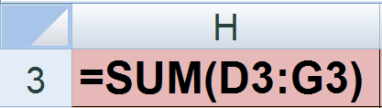
SUM function
(sums a range of values)
Write an Excel formula in cell Gradebook!H3, to calculate the total points earned for the student Teri Brown. Copy the formula so it calculates the total points earned for each student in the list.

Slide 5
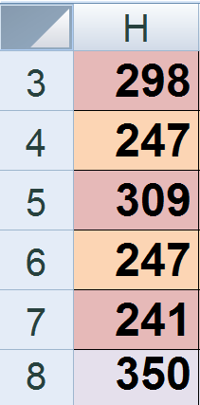
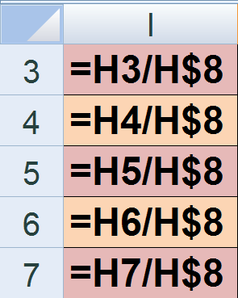
Keeping Cell references the same when copying formulas
Write an Excel formula in cell Gradebook!I3, to calculate the percentage grade for the student Teri Brown. Copy the formula so it calculates the percentage grade for each student in the list.

Slide 6
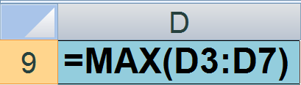
Max function
(returns the maximum value in a range)
Write an Excel formula in cell Gradebook!D9 to calculate the highest score received on Lab1. Copy the formula so it calculates the highest score received on each Lab, Midterm, Final, etc.
What about the green triangles?
Excel tries to be smart and tell you that you might have an error in your formula. How do you fix this? First check, do you have an error in the formula. If not, just ignore the error.

Slide 7
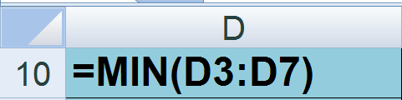
Min function
(returns the minimum value in a range)
Write an Excel formula in cell Gradebook!D10 to calculate the lowest score received on Lab1. Copy the formula so it calculates the lowest score received on each Lab, Midterm, Final, etc.

Slide 8
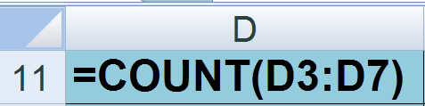
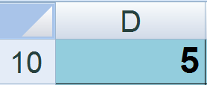
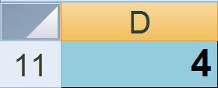
Count function
(returns the number of items in a range)
Write an Excel formula in cell Gradebook!D11 to calculate the number of scores recorded for Lab 1. Copy the formula so it calculates the number of scores recorded on each Lab, Midterm, Final, etc.
What happens if you delete the Lab 1 score for Teri Brown?

Slide 9
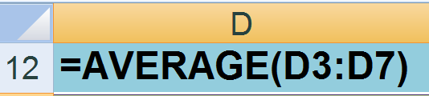
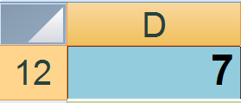
Average function
(averages a range of values)
Write an Excel formula in cell Gradebook!D12 to calculate the average score for Lab 1. Copy the formula so it calculates the average score for each Lab, Midterm, Final, etc.

Slide 10
In cell Gradebook!K12 type in the function: =SUM(D12:H12)
What value displays in the cell? 537
Open the calculator and type in:
7 + 12 + 80 + 169 + 268 = 536
What’s Wrong????
We have formatted our cells to display as whole numbers, but we haven’t changed the value in the cell.

Slide 11

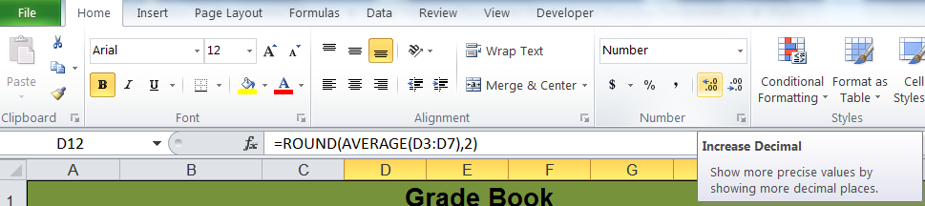

Format cells in D12:H12 to display numbers as two decimal places
Highlight cells D12:H12 to select them
Click the increase decimal button two times
Now the cells display with 2 decimal places

Slide 12
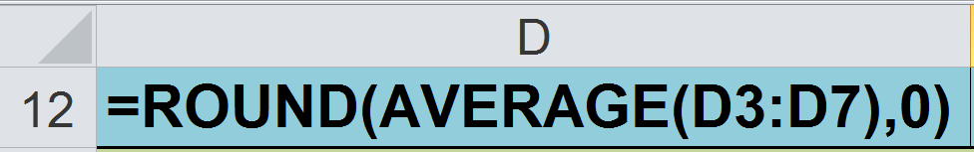
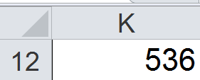
The Round Function changes the precise value of a number, not just its display
Syntax: =Round (number, num_digits)
Num_digits: Specified number of decimal Places
Value | Rounding
0 | Round to the nearest whole number
1 | Round to the nearest tenth (0.1, 0.2, ..)
-1 | Round to the nearest ten (10, 20, …)

Slide 13
The COUNTIF Function counts the number of items in a range that meet a specific criteria.
=COUNTIF (range, criteria)
Range
One or more cells to count, including numbers or names, arrays, or cell references that contain numbers.
criteria
A number, expression, cell reference, or text string that defines which cells will be counted. For example, criteria can be expressed as 32, ">32", B4, or "apples".
NOTE: The comma in the parentheses separates the arguments, so you can only use commas between arguments..

Slide 14
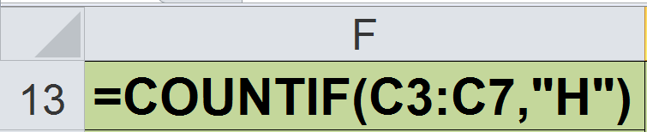
Countif function Example--Using text as a criteria
(counts the number of items in a range that meet a specific criteria)
Write an Excel formula in cell Gradebook!F13 to determine the number of honor students in this class.

Slide 15
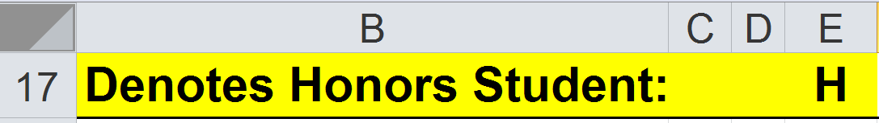
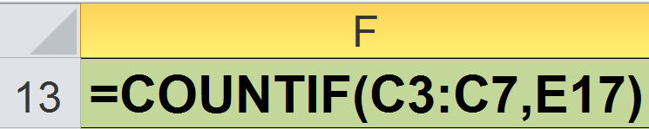
Countif function Example--Using a cell reference as criteria
(counts the number of items in a range that meet a specific criteria)
Write an Excel formula in cell Gradebook!F13 to determine the number of honor students in this class.

Slide 16
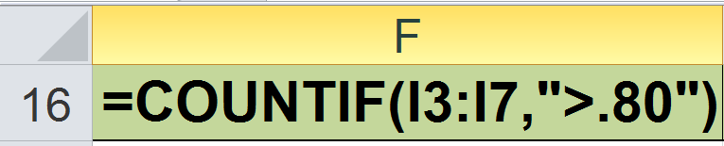
Countif function Example--Using a cell reference as criteria
(counts the number of items in a range that meet a specific criteria)
Write an Excel formula in cell Gradebook!F16 to determine the number of students in the class who scored greater than 80%.

Slide 17
SUMIF (Sums the values in a range that meet a specific criteria)
SUMIF(range, criteria, sum-range)
Range
The range of cells that you want evaluated by criteria. Cells in each range must be numbers or names, or references that contain numbers.
criteria
The criteria in the form of a number, expression, a cell reference, or text that defines which cells will be added. For example, criteria can be expressed as 32, ">32", B5, 32, "32", or "apples"
sum_range
The actual cells to add, if you want to add cells other than those specified in the range argument.

Slide 18
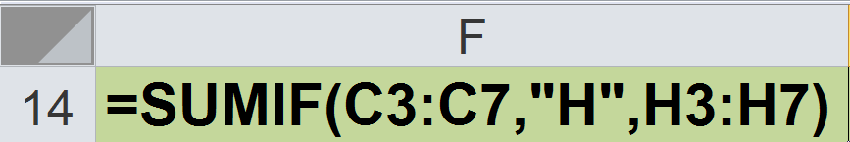
Sumif function Example--Using text as a criteria
(sums the values in a range that meet a specific criteria)
Write an Excel formula in cell Gradebook!F14 to calculate the total number of points earned by Honor students for this assignment/exam .

Slide 19
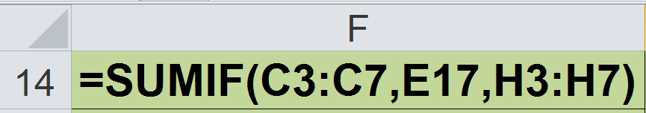
Sumif function Example--Using a cell reference as a criteria
(sums the values in a range that meet a specific criteria)
Write an Excel formula in cell Gradebook!F14 to calculate the total number of points earned by Honor students for this assignment/exam .

Slide 20
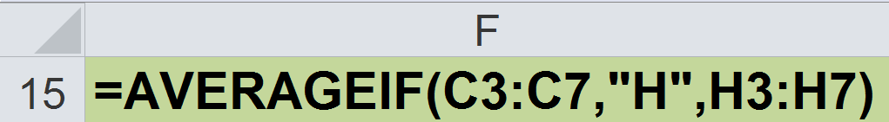
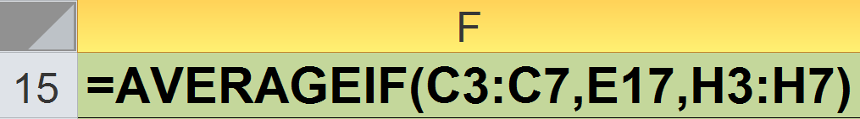
Averageif function
(averages the values in a range that meet a specific criteria)
Write an Excel formula in cell Gradeook!F15 to calculate the average number of points earned by Honor students for this assignment/exam .

Slide 21
Rank Returns the rank of a number in a list of numbers. The rank of a number is its size relative to other values in a list. (If you were to sort the list, the rank of the number would be its position.)
=RANK(Number,Ref,Order)
Number
The number whose rank you want to find
Ref
The list of numbers
Order
Specifies the sort order
0 or left blank—Descending order
Positive number—Ascending order

Slide 22
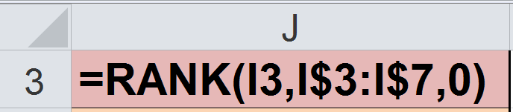
Rank function
(Returns the rank of a number in a list of numbers.)
Write an Excel formula in cell Gradeook!J3 to calculate the rank of each student. Rank the list in descending order

Slide 23
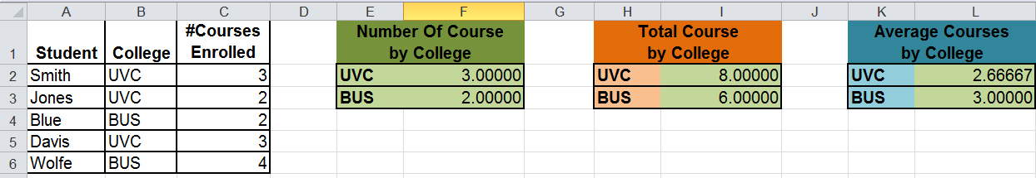
Student Courses worksheet
File 1 - Excel Training Part 1

Slide 24
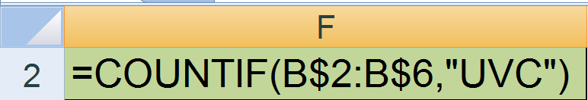
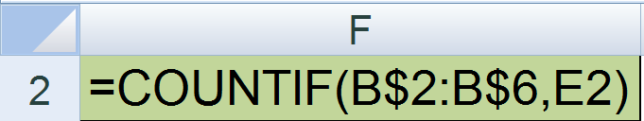
Countif Function -- You try it!
Write a formula in cell ‘Student Courses’!F2 ONLY to display the total number of students in the college UVC.
Write a formula in cell ‘Student Courses’!F2, which can be copied down to cell C10, to display the number of students by college.

Slide 25
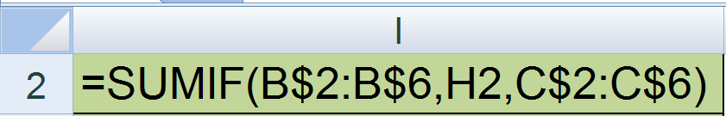
Sumif Function —You try it!
Write a formula in cell ‘Student Courses’!I2, which can be copied down to cell C13, to summarize the number of courses being taken by students in this college.

Slide 26
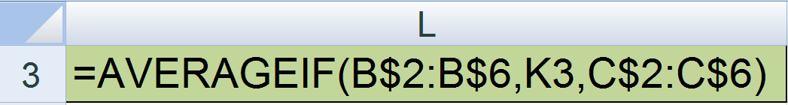
Averageif Function —You try it!
Write a formula in cell ‘Student Courses’!L2, which can be copied down to cell C13, to average the number of courses being taken by students in this college.

Slide 27
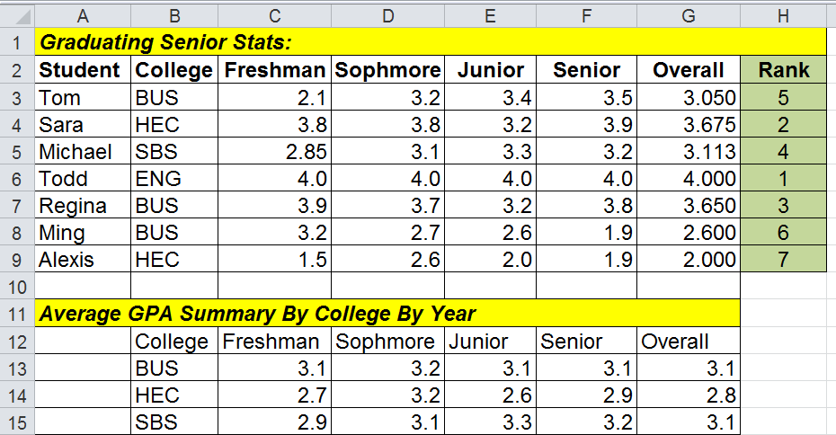
GPA Summary worksheet
Examples from the Excel Training Part 1 File

Slide 28
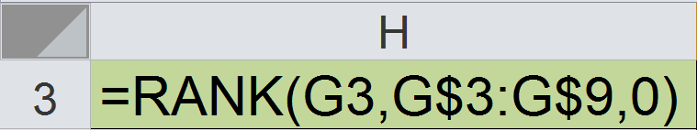
Rank function—You try it
(Returns the rank of a number in a list of numbers.)
Write an Excel formula in cell GPA Summary!H3 to calculate the rank of each student. Rank the list in descending order

Slide 29
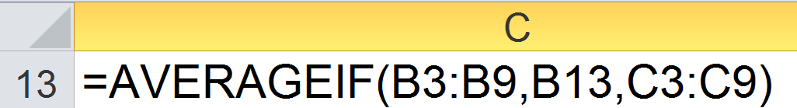
Averageif function—You try it
(averages the values in a range that meet a specific criteria)
Write an Excel formula in cell GPA Summary!C13, ONLY (do not copy formula yet), to calculate the Average GPA Summary By College By Year.

Slide 30
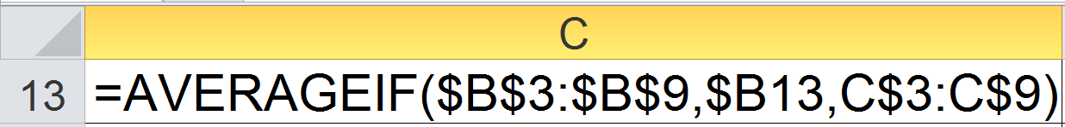
Averageif function
(averages the values in a range that meet a specific criteria)
Write an Excel formula in cell GPA Summary!C13, which may be copied across to cell G13, and down to cell G15, to calculate the Average GPA Summary By College By Year.

Slide 31
Using Multiple Worksheets in a Workbook
File 2 - Excel Training Part 1

Slide 32
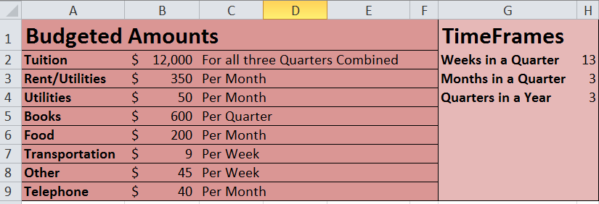
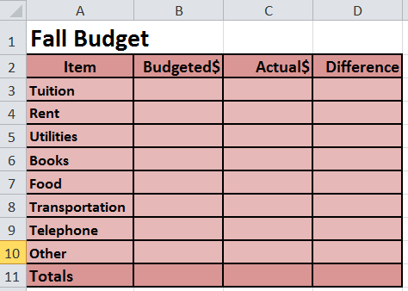

Slide 33
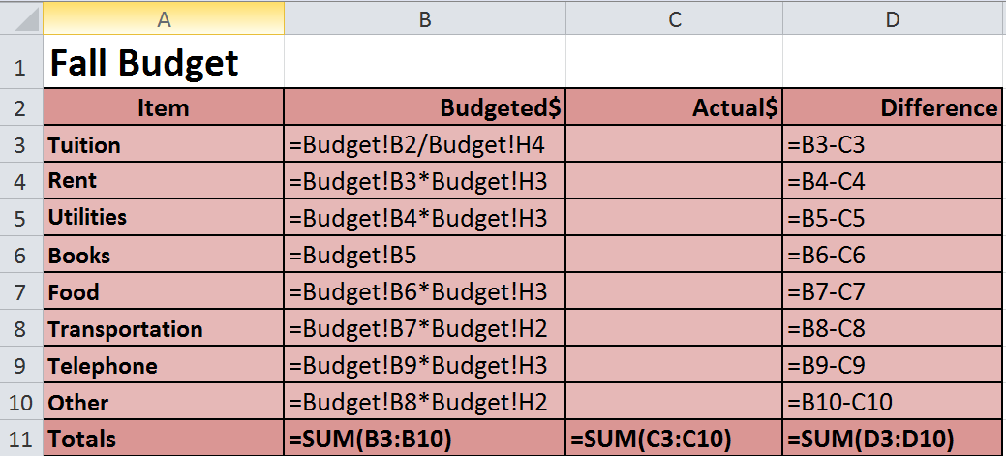
Point and Click to create Formulas

Slide 34

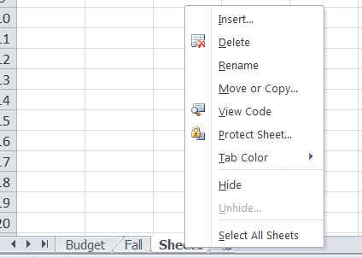
Creating Multiple Worksheets
1. Click to add a new worksheet
3. Click Rename
2. Right click on the new tab

Slide 35

Name the new worksheet, Winter. Create new worksheets named, Spring, and Summary

Slide 36
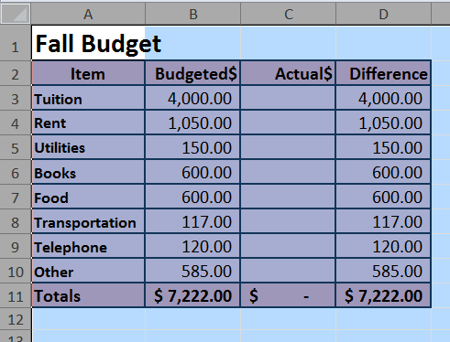
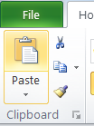
Copy the Fall worksheet to the worksheets, Winter, Spring, and Summary
1. Click top of worksheet to select the entire worksheet
2. Click Copy icon

Slide 37
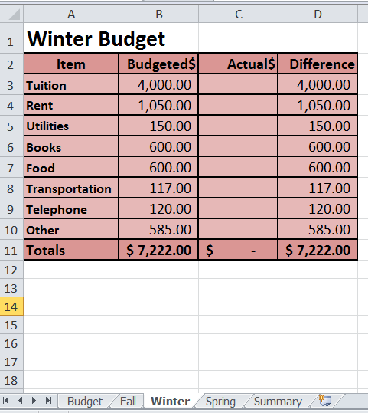
2. Click on Cell A1
3. Click Paste
4. Change the title to Winter Budget
5. Follow the instructions to paste the Fall worksheet into the Spring and Summary Worksheets
1. Click Winter Tab

Slide 38
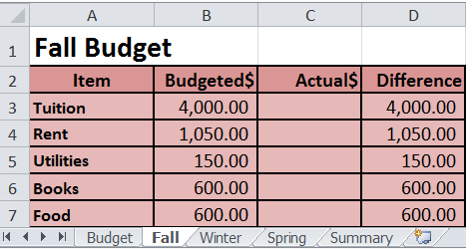
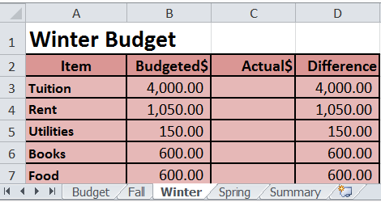
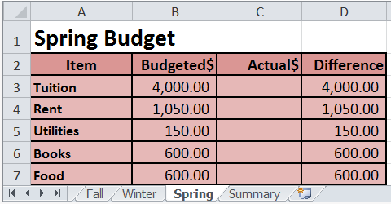
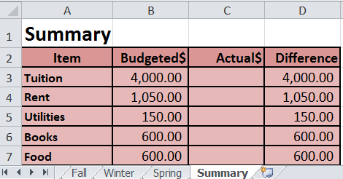
The four spreadsheets

Slide 39
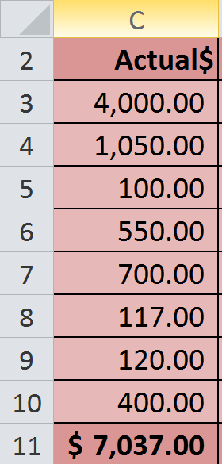
Type in Actual Fall Expenses

Slide 40
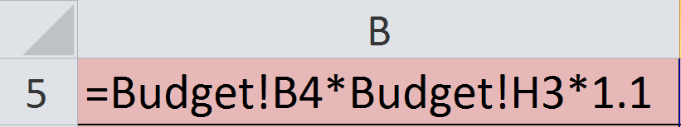
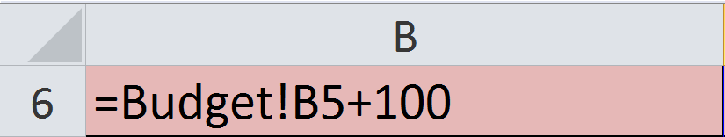
Winter Quarter Budget
Budgeted amount for utilities will increase by 10%
Book Budget amount will increase by $100

Slide 41
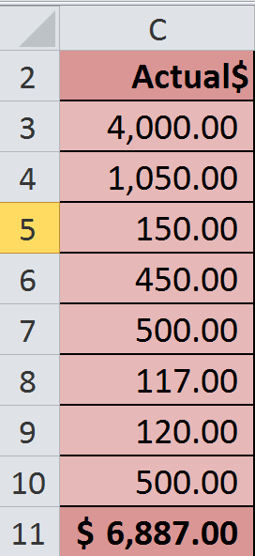
Type in Actual Winter Expenses

Slide 42
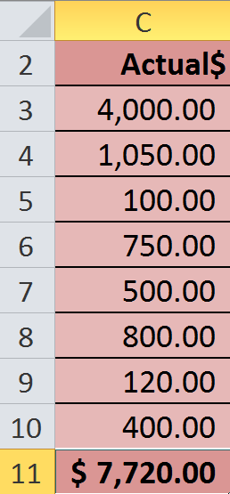
Budgeted amounts for Spring Quarter Stay the same. Actual amounts are shown

Slide 43
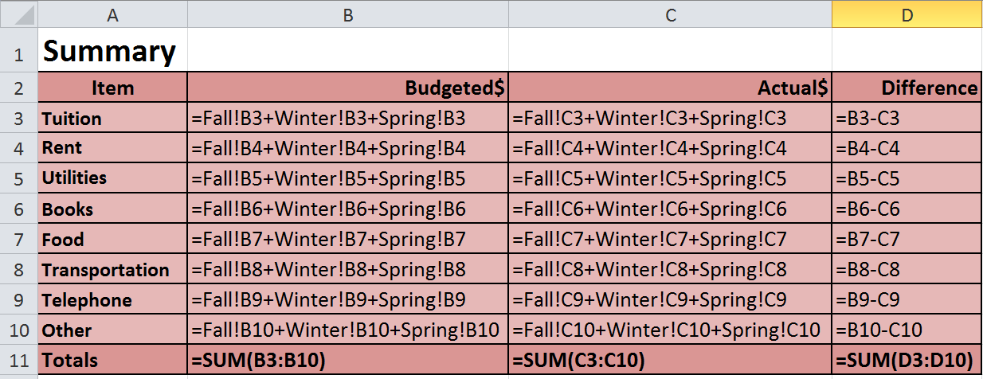
Summary Worksheet

Slide 44
Excel Issues
File 3 - Excel Training Part 1

Slide 45
=IF(OR(ISBLANK(B4),ISBLANK(D4),B4=0,D4=0),0,D4/B4)

